Slide 1






TrendMart Sales Analysis
Presenter: Nihat Naghizade

Slide 2



Overview
Introduction and Objective
About the Dataset
Top Selling Product Categories
Analysis of Sales by Region
Sales Trends
Relationship Between Customer Age and Sales
Proposals and Conclusion

Slide 3




Introduction and Objective
The main goal of this project is to help the company better understand its product performance and customer behavior by analyzing TrendMart's sales data.

Slide 4



Which products sell the most?
Write identity or value here
Based on this analysis, it aims to find the answer to the fourth question
Which age groups spend the most?
What are the time trends in sales?

Slide 5


About the Dataset
İn this project looked at two datasets: one “Products”, the other “Sales”

Slide 6
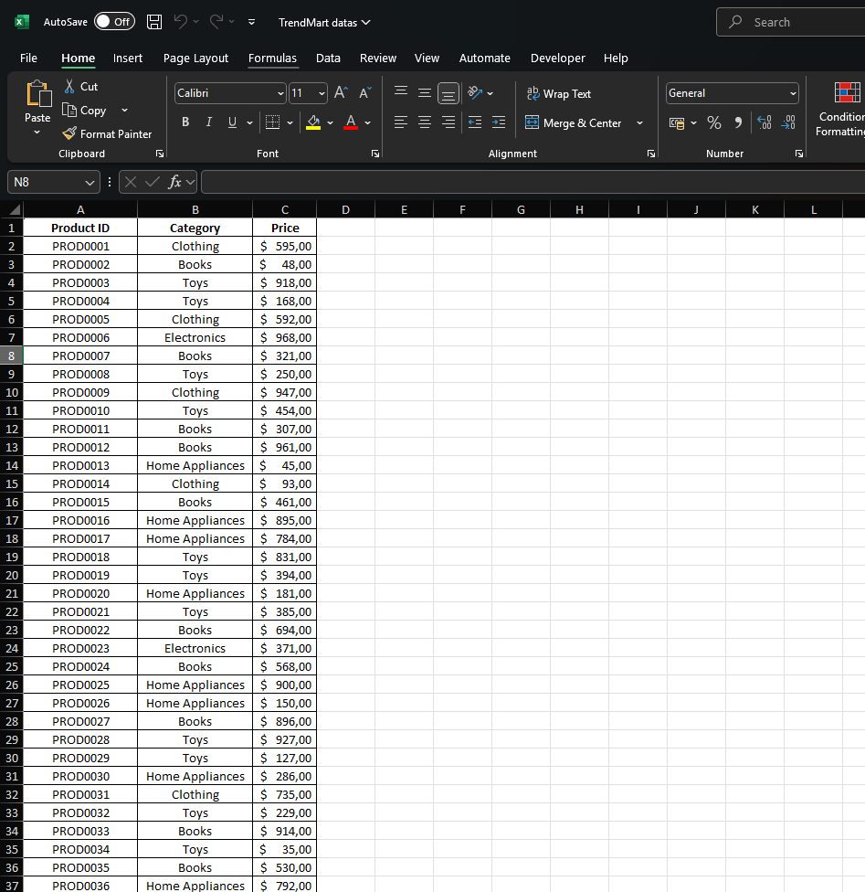
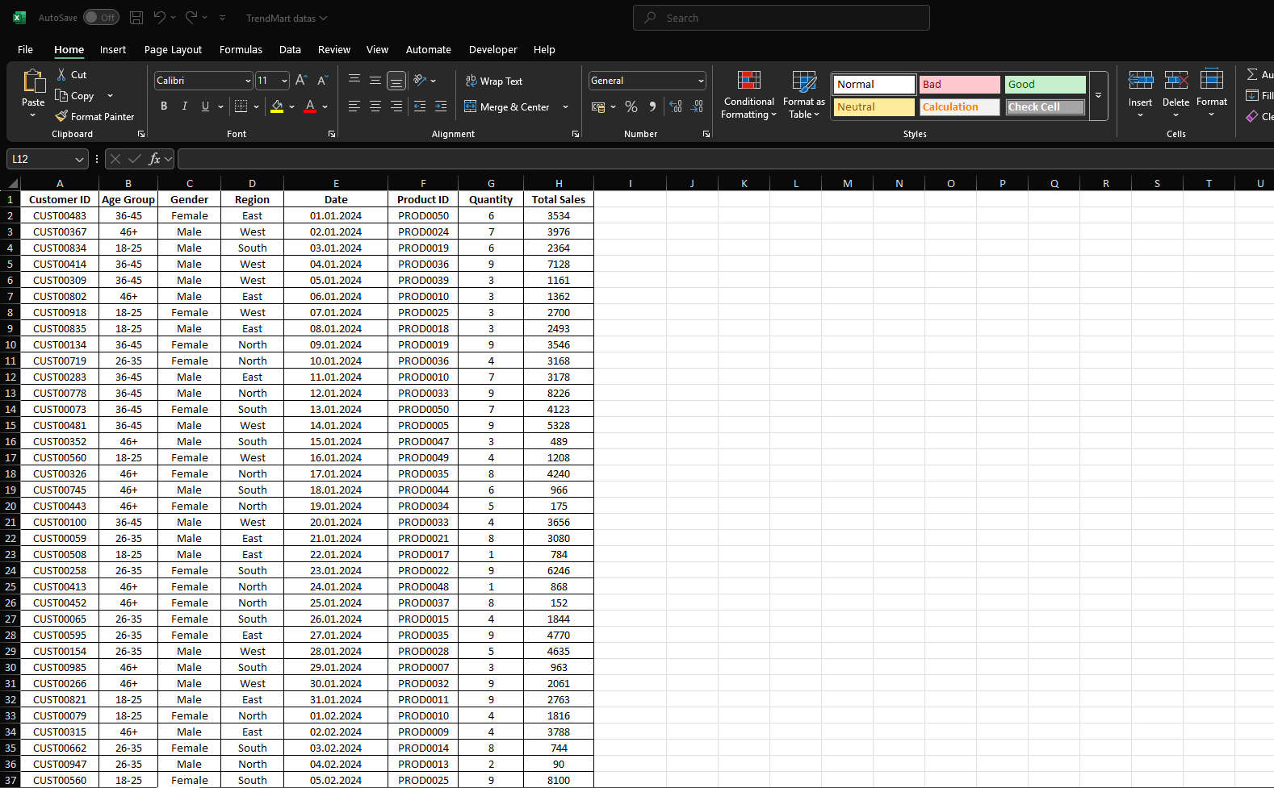

Slide 7


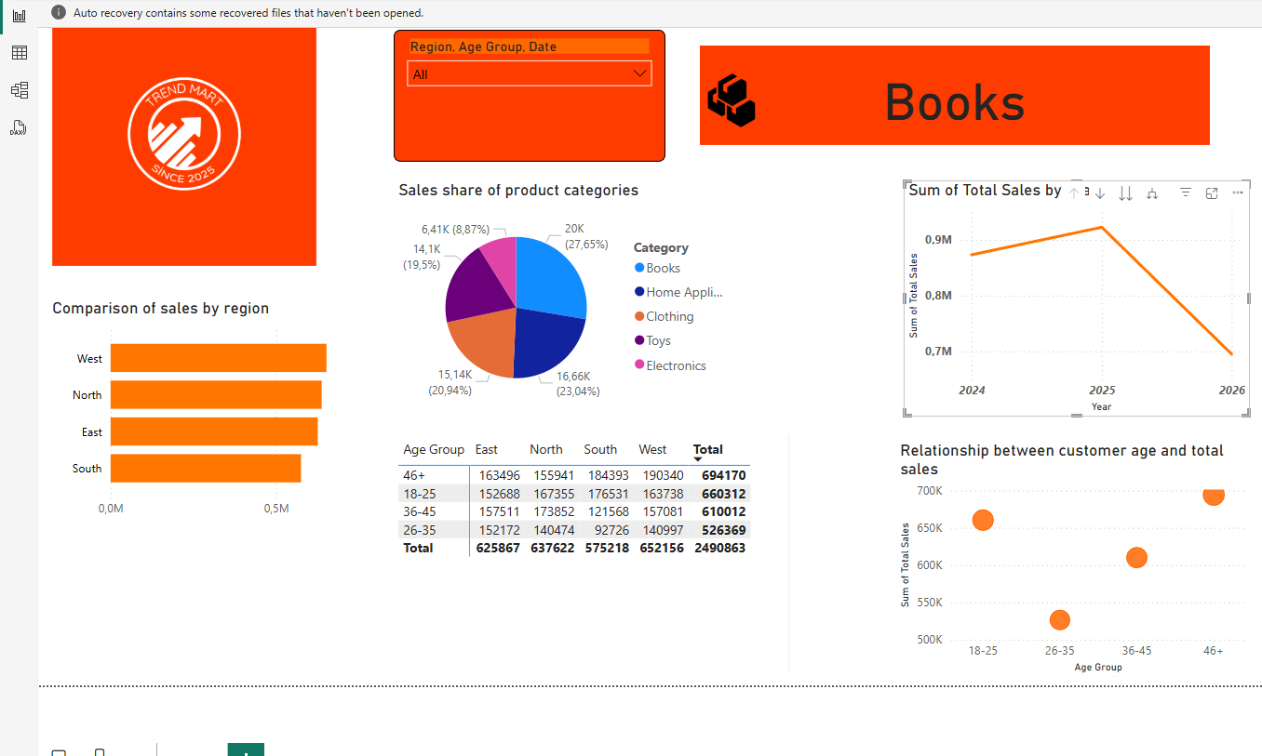


Best Selling Product Categories

Slide 8
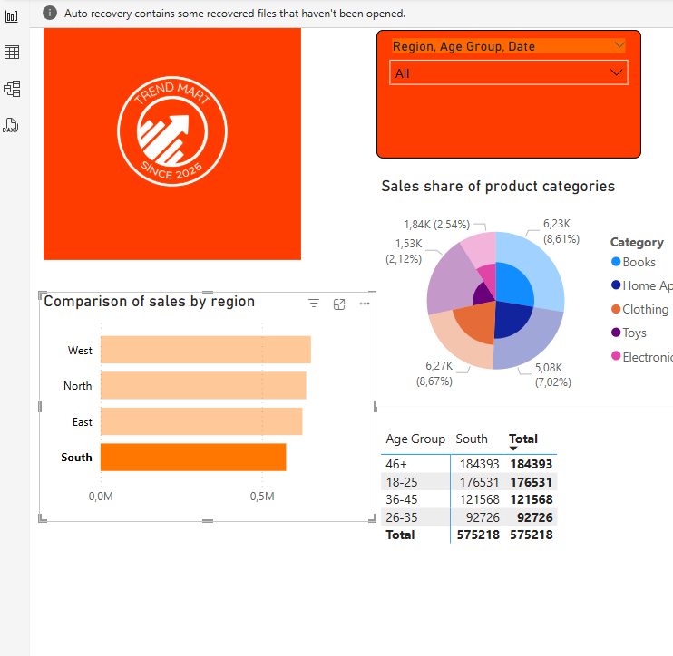

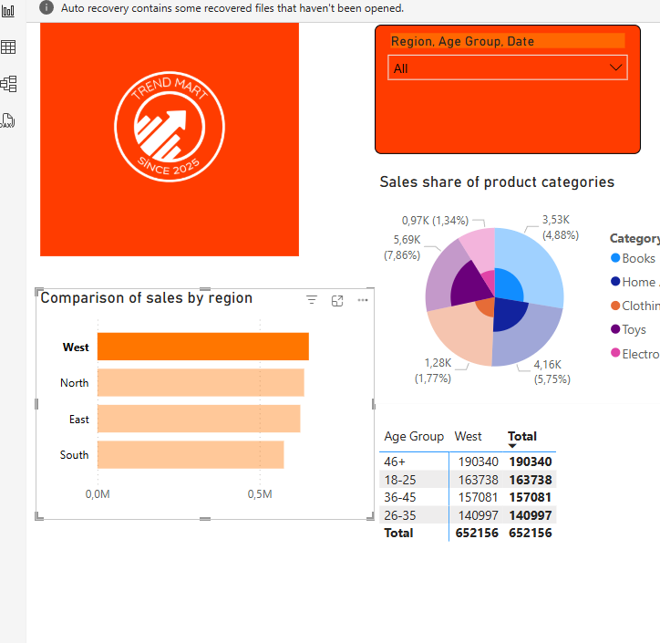
Sales Analysis by Region

Slide 9

Sales Trends

Slide 10


The Relationship Between Customer Age and Sales
01

Slide 11




Suggestions and Conclusion

Slide 12





Nihat Naghizade
nihatnzade200@gmail.com
Nihat Walker

